Slide 1
CS Club Weekly Meeting
11/05/20

Slide 2
Agenda
Docker!

Slide 3
How to install Docker?
Windows: https://docs.docker.com/docker-for-windows/install/
Mac: https://docs.docker.com/docker-for-mac/install/

Slide 4

What is Docker?
Founded in 2010, made available for public use in 2013
Allows users to package software into efficient chunks called containers
Containers can run on any Linux server
More lightweight than a virtual machine
It’s almost like a JVM but for any application
“Write once, run anywhere”

Slide 5
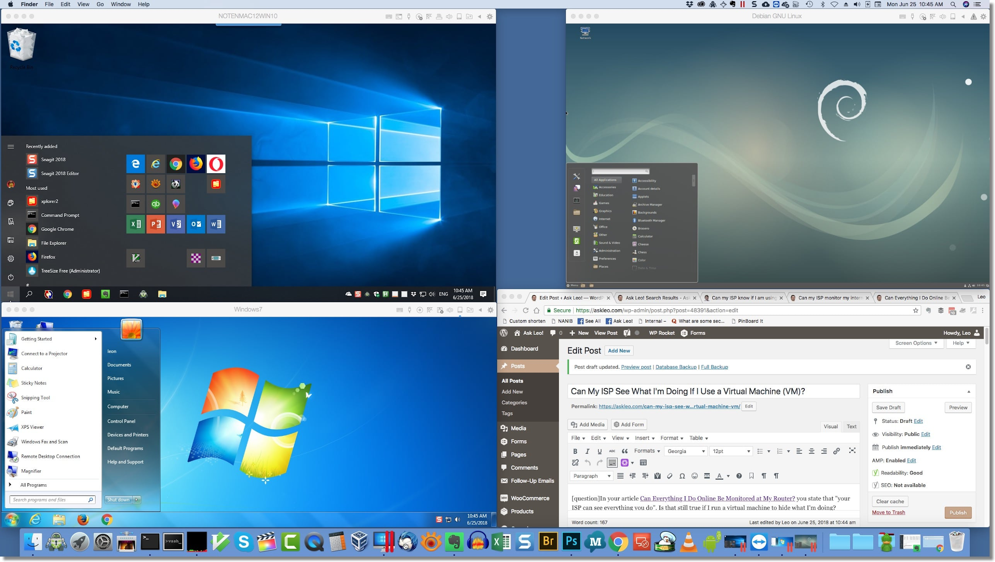
What is a Virtual Machine?
In computing, a virtual machine (VM) is an emulation of a computer system. Virtual machines are based on computer architectures and provide functionality of a physical computer. Their implementations may involve specialized hardware, software, or a combination. - Wikipedia

Slide 6
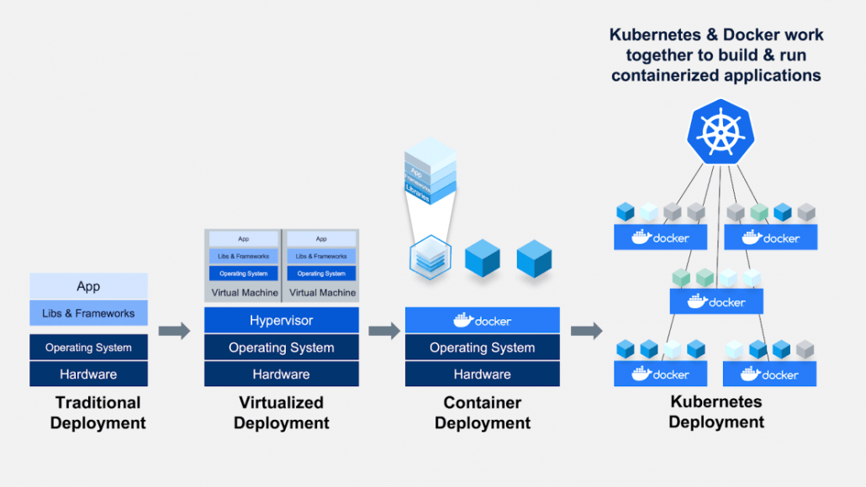
What is Docker (simplified)?
We’re going to take our program or programs (in any programming language) and shove it into a Docker container that can then be run on any computer or server that has Docker installed.
Containers can be run concurrently using distributed systems such as AWS or Kubernetes

Slide 7
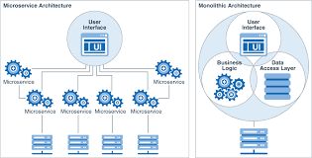
Docker works well with microservices

Slide 8
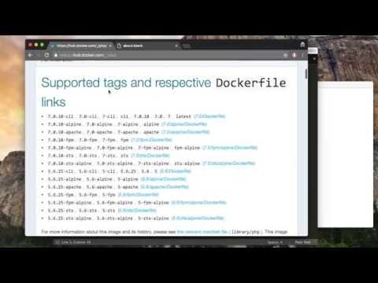
This video explains Docker really well in a short amount of time

Slide 9
Once you have docker installed...
Ensure it is installed by typing ‘docker’ into your terminal/CMD
You should see a bunch of commands printed out
We will now attempt to pull an image and build our own image
Run ‘docker pull hello-world` on the command line, you should see a bunch of text appear explaining what just happened
Now try running ‘docker images’ on the command line
You should see hello-world listed!

Slide 10
Building our own image (now we’re getting crazy!)
What do we need to build an image
Dockerfile
Something to put in our Dockerfile
Like some python code
The code we need to run our example can be found here: https://github.com/williamEstony/cs_club/tree/master/Docker
To build the image, get your terminal in the same directory as the 3 files found in the above repo
Run ‘docker build -t pythonimage .
Then run ‘docker run pythonimage’
You should see ‘Hello from inside a docker container’ printed to the console
NOTE: the example used above was adapted from the following - https://dockerlabs.collabnix.com/beginners/dockerfile/lab_dockerfile_python.html

